Slide 1
COMP 4500
Week 6 - Wednesday

Slide 2
Last time
What did we talk about last time?
Finished Exam 1 post mortem
Data compression example
Mergesort

Slide 3
Questions?

Slide 4
Assignment 3

Slide 5
Logical warmup
On the planet Og, there are green people and red people
Likewise, there are northerners and southerners
Green northerners tell the truth
Red northerners lie
Green southerners lie
Red southerners tell the truth
Consider the following statements by two natives named Ork and Bork:
  Ork: Bork is from the north
  Bork: Ork is from the south
  Ork: Bork is red
  Bork: Ork is green
What are the colors and origins of Ork and Bork?

Slide 6
Divide and Conquer

Slide 7
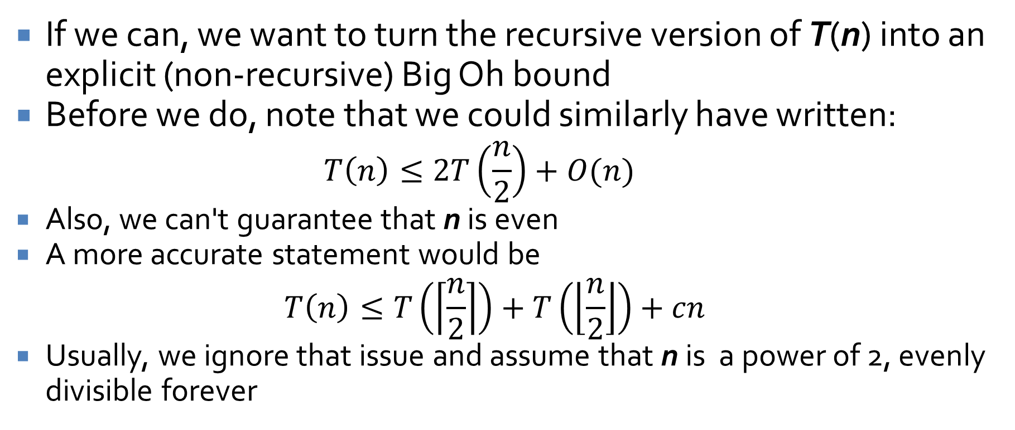
Recursive running time
If we can, we want to turn the recursive version of T(n) into an explicit (non-recursive) Big Oh bound
Before we do, note that we could similarly have written:
  $$T\left(n\right)≤2T\left(\frac{n}{2}\right)+O(n)$$
  Also, we can't guarantee that n is even
  A more accurate statement would be
  $$T\left(n\right)≤T\left(\left\lceil \frac{n}{2}\right\rceil \right)+T\left(\left\lfloor \frac{n}{2}\right\rfloor \right)+cn$$
  Usually, we ignore that issue and assume that n is a power of 2, evenly divisible forever

Slide 8
Intuition about mergesort recursion
Each time, the recursion cuts the work in half while doubling the number of problems
  The total work at each level is thus always cn
To go from n to 2, we have to cut the size in half (log₂ n) – 1 times
cn
cn
cn
cn
cn/2
cn/2
cn/4
cn/4
cn/4
cn/4

Slide 9
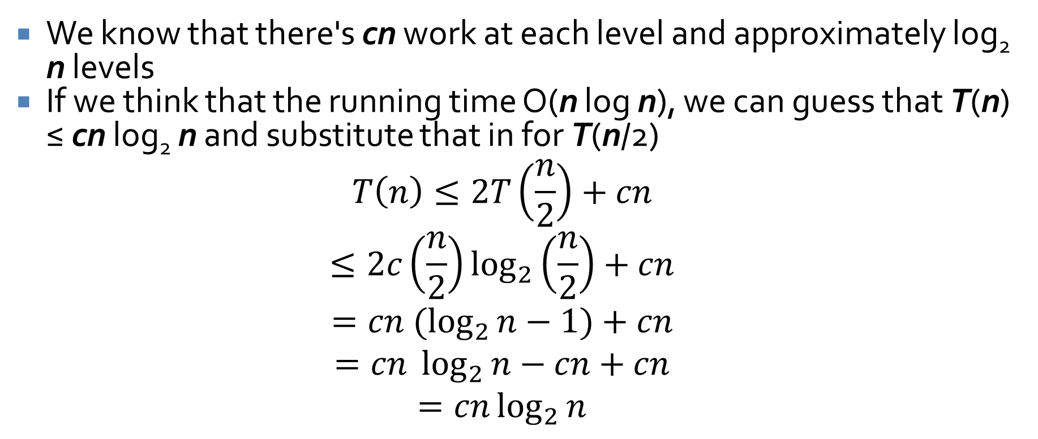
Checking a solution
We know that there's cn work at each level and approximately log₂ n levels
If we think that the running time O(n log n), we can guess that T(n) ≤ cn log₂ n and substitute that in for T(n/2)
$$T\left(n\right)≤2T\left(\frac{n}{2}\right)+cn$$
$$≤2c\left(\frac{n}{2}\right)\log_{2}\left(\frac{n}{2}\right)+cn$$
$$=cn (\log_{2}{n}−1)+cn$$
$$=cn \log_{2}{n}−cn+cn$$
$$=cn\log_{2}{n}$$

Slide 10
Divide and conquer
Divide and conquer algorithms are ones in which we divide a problem into parts and recursively solve each part
Then, we do some work to combine the solutions to each part into a final solution
Divide and conquer algorithms are often simple
However, their running time can be challenging to compute because recursion is involved

Slide 11
Recursively defined sequences
Defining a sequence recursively as with Mergesort is called a recurrence relation
The initial conditions give the starting point
Example:
  Initial conditions
    T(0) = 1
    T(1) = 2
  Recurrence relation
    T(k) = T(k-1) + kT(k-2) + 1, for all integers k ≥ 2
  Find T(2), T(3), and T(4)

Slide 12
Writing recurrence relations in multiple ways
Consider the following recurrence relation:
  T(k) = 3 T(k-1) – 1, for all integers k ≥ 1
Now consider this one:
  T(k+1) = 3 T(k) – 1, for all integers k ≥ 0
Both recurrence relations have the same meaning

Slide 13
Differences in initial conditions
Even if the recurrence relations are equivalent, different initial conditions can cause a different sequence
Example:
  T(k) = 3 T(k-1), for all integers k ≥ 2
  T(1) = 2
  S(k) = 3S(k-1), for all integers k ≥ 2
  S(1) = 1
  Find T(1) , T(2) , and T(3)
  Find S(1) , S(2) , and S(3)

Slide 14
Compound interest
Interest is compounded based on some period of time
We can define the value recursively
Let i is the annual percentage rate (APR) of interest
Let m be the number of times per year the interest is compounded
Thus, the total value of the investment at the k^{th} period is
  P(k) = P(k-1) + P(k-1)(i/m), k ≥ 1
  P(0) = initial principle

Slide 15
Solving Recurrence Relations

Slide 16
Recursion
… is confusing
We don't naturally think recursively (but perhaps you can raise your children to think that way?)
With an interest rate of i, a principle of P(0) , and m periods per year, the investment will yield P(0)(i/m + 1)^{k} after k periods

Slide 17
Finding explicit formulas by iteration
We want to be able to turn recurrence relations into explicit formulas whenever possible
Often, the simplest way is to find these formulas by iteration
The technique of iteration relies on writing out many expansions of the recursive sequence and looking for patterns
That's it

Slide 18
Iteration example
Find a pattern for the following recurrence relation:
  T(k) = T(k-1) + 2
  T(0) = 1
Start at the first term
Write the next below
Do not combine like terms!
Leave everything in expanded form until patterns emerge

Slide 19
Arithmetic sequence
In principle, we should use mathematical induction to prove that the explicit formula we guess actually holds
The previous example (odd integers) shows a simple example of an arithmetic sequence
These are recurrences of the form:
  T(k) = T(k-1) + d, for integers k ≥ 1
Note that these recurrences are always equivalent to
  T(n) = T(0) + dn, for all integers n ≥ 0

Slide 20
Geometric sequence
Find a pattern for the following recurrence relation:
  T(k) = rT(k-1), k ≥ 1
  T(0) = a
Again, start at the first term
Write the next below
Do not combine like terms!
Leave everything in expanded form until patterns emerge

Slide 21
Geometric sequence
It appears that any geometric sequence with the following form
  T(k) = rT(k-1), k ≥ 1
is equivalent to
  T(n) = T(0)r^{n}, for all integers n ≥ 0
This result applies directly to compound interest calculation

Slide 22
Employing outside formulas
Intelligent pattern matching gets you a long way
However, it is sometimes necessary to substitute in some known formula to simplify a series of terms
Recall
  Geometric series: 1 + r + r² + … + r^{n} = (r^{n+1} – 1)/(r – 1)
  Arithmetic series: 1 + 2 + 3 + … + n = n(n + 1)/2

Slide 23
How many edges are in a complete graph?
In a complete graph, every node is connected to every other node
If we want to make a complete graph with k nodes, we can take a complete graph with k – 1 nodes, add a new node, and add k – 1 edges (so that all the old nodes are connected to the new node)
Recursively, this means that the number of edges in a complete graph is
  S(k) = S(k-1) + (k – 1), k ≥ 2
  S(1) = 0 (no edges in a graph with a single node)
Use iteration to solve this recurrence relation

Slide 24
How long does binary search take?
We can model the running time for binary search as a recurrence relation
  T(n) = T(n/2) + c, k ≥ 2
  T(1) = c
Use iteration to solve this recurrence relation
Instead of plugging in values 1, 2, 3,… , try powers of two: 1, 2, 4, 8,…

Slide 25
Further Recurrence Relations

Slide 26
Three-sentence Summary of Further Recurrence Relations

Slide 27
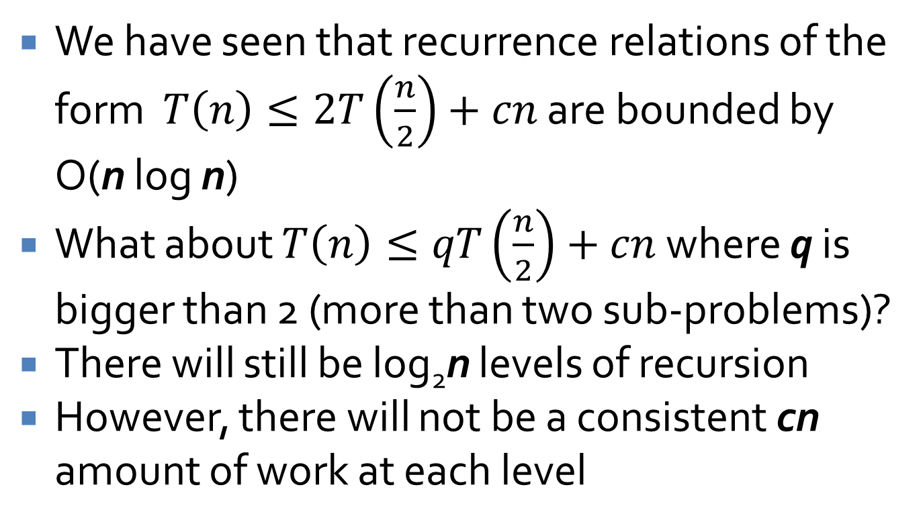
Further recurrence relations
We have seen that recurrence relations of the form $T\left(n\right)≤2T\left(\frac{n}{2}\right)+cn$ are bounded by O(n log n)
What about $T\left(n\right)≤qT\left(\frac{n}{2}\right)+cn$ where q is bigger than 2 (more than two sub-problems)?
There will still be log₂n levels of recursion
However, there will not be a consistent cn amount of work at each level

Slide 28
Consider q = 3
cn
cn
(3/2)cn
(9/4)cn
cn/2
cn/2
cn/2
cn/4
cn/4
cn/4
cn/4
cn/4
cn/4
cn/4
cn/4
cn/4

Slide 29
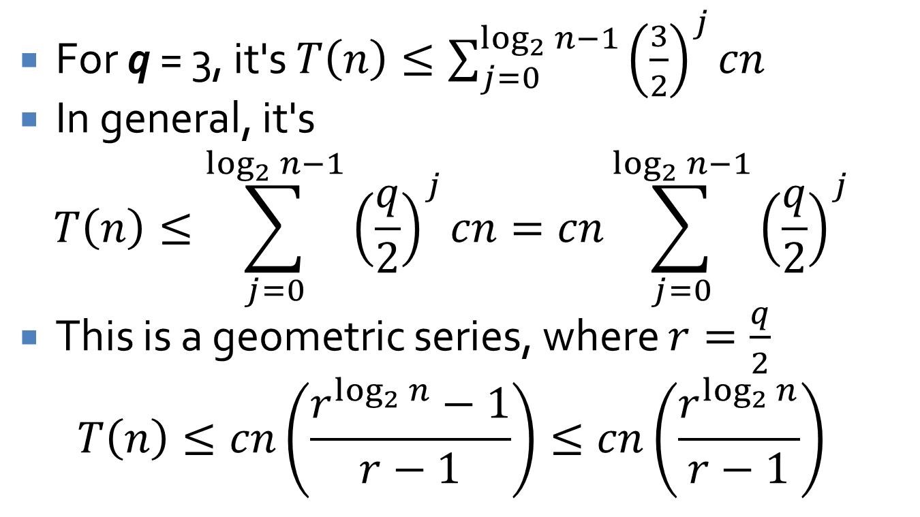
Converting to summation
For q = 3, it's $T\left(n\right)≤\sum_{j=0}^{\log_{2}{n−1}}{{\left(\frac{3}{2}\right)}^{j}cn}$
In general, it's
$$T\left(n\right)≤\sum_{j=0}^{\log_{2}{n−1}}{{\left(\frac{q}{2}\right)}^{j}cn}=cn\sum_{j=0}^{\log_{2}{n−1}}{{\left(\frac{q}{2}\right)}^{j}}$$
This is a geometric series, where $r=\frac{q}{2}$
$$T\left(n\right)≤cn\left(\frac{r^{\log_{2}{n}}−1}{r−1}\right)≤cn\left(\frac{r^{\log_{2}{n}}}{r−1}\right)$$

Slide 30
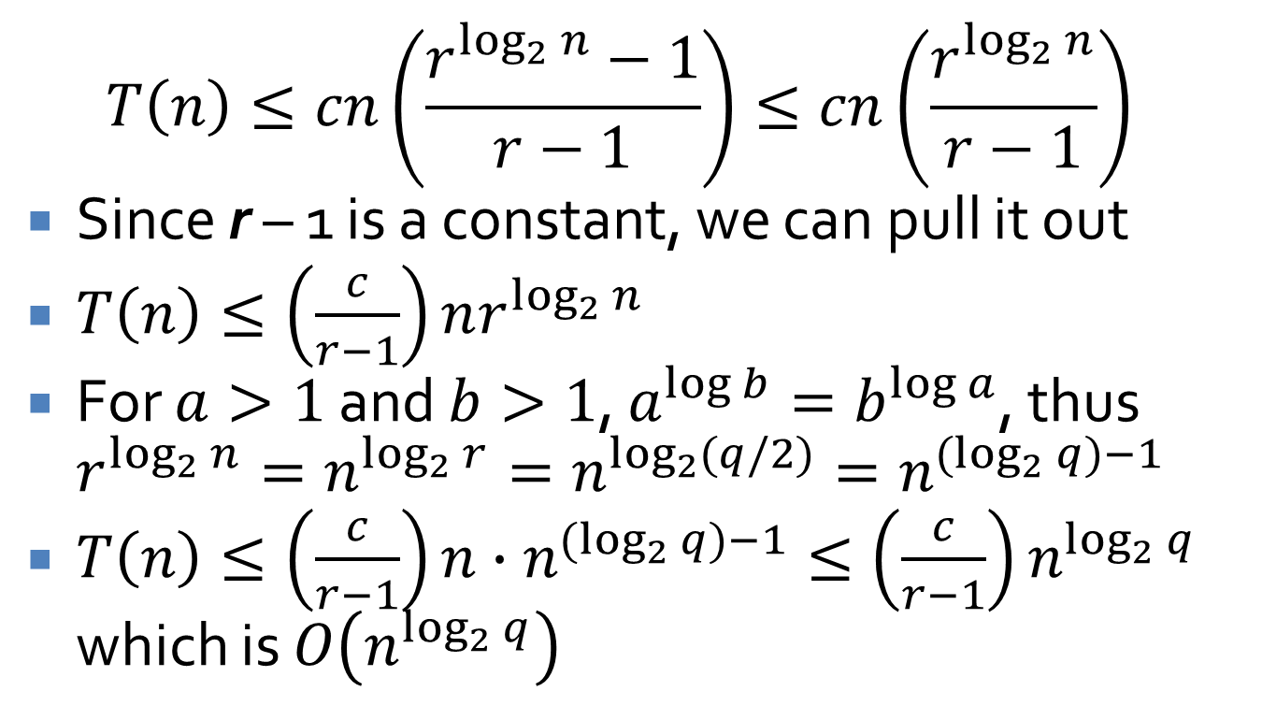
Final bound
$$T\left(n\right)≤cn\left(\frac{r^{\log_{2}{n}}−1}{r−1}\right)≤cn\left(\frac{r^{\log_{2}{n}}}{r−1}\right)$$
Since r – 1 is a constant, we can pull it out
$T\left(n\right)≤\left(\frac{c}{r−1}\right)nr^{\log_{2}{n}}$
For $a>1$ and $b>1$, $a^{\log{b}}=b^{\log{a}}$, thus $r^{\log_{2}{n}}=n^{\log_{2}{r}}=n^{\log_{2}{(q/2)}}=n^{(\log_{2}{q})−1}$
$T\left(n\right)≤\left(\frac{c}{r−1}\right)n∙n^{(\log_{2}{q})−1}≤\left(\frac{c}{r−1}\right)n^{\log_{2}{q}}$ which is $O\left(n^{\log_{2}{q}}\right)$

Slide 31
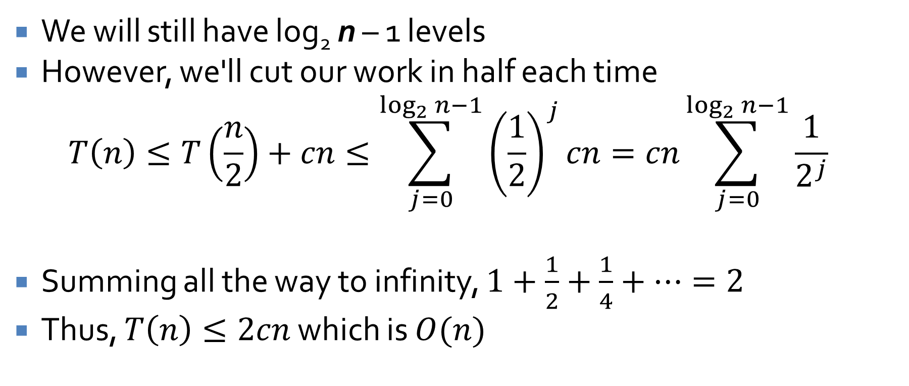
What about a single sub-problem?
We will still have log₂ n – 1 levels
However, we'll cut our work in half each time
$$T\left(n\right)≤T\left(\frac{n}{2}\right)+cn≤\sum_{j=0}^{\log_{2}{n−1}}{{\left(\frac{1}{2}\right)}^{j}cn}=cn\sum_{j=0}^{\log_{2}{n−1}}{\frac{1}{2^{j}}}$$
Summing all the way to infinity, $1+\frac{1}{2}+\frac{1}{4}+…=2$
Thus, $T\left(n\right)≤2cn$ which is $O(n)$

Slide 32
What might that look like in code?
Here's a non-recursive version in Java
We've just shown that this is O(n), in spite of the two for loops
int counter = 0;
for( int i = 1; i <= n; i *= 2 )
for( int j = 1; j <= i; j++ )
counter++;

Slide 33
Quiz

Slide 34
Upcoming

Slide 35
Next time…
Counting inversions

Slide 36
Reminders
Assignment 3 is due on Friday
Read section 5.3
Extra credit opportunities (0.5% each):
  Hristov teaching demo: 2/19 11:30-12:25 a.m. in Point 113
  Hristov research talk: 2/19 4:30-5:30 p.m. in Point 139

